Slide 1
CS6200 Information Retrieval Fall 2018 Nov 19, 2018
Information about the search engine: Netflix
- Kinshuk Juneja

Slide 2

Overview
Netflix is the world’s leading entertainment service that provides on-demand thousands of movies, tv shows and documentaries that subscribed users can watch anywhere and anytime on their website or app, all without commercials.
Netflix subscribers: 130 million (Last updated 7/16/18)
Netflix daily searches: 3 million
Average amount of video users watches on Netflix per week: 1 billion hours (Last updated 4/19/17).
Estimated amount of ads Netflix users avoid by watching it: 160 hours of ads per year (Last updated 5/11/16).
Estimate number of people Netflix reaches: 300 million (Last updated 19/26/17).
Number of international Netflix subscribers: 68.29 million (Last updated 4/16/18).
Percentage of US streaming service viewers Netflix reaches: 75% (Last updated 4/10/17).

Slide 3

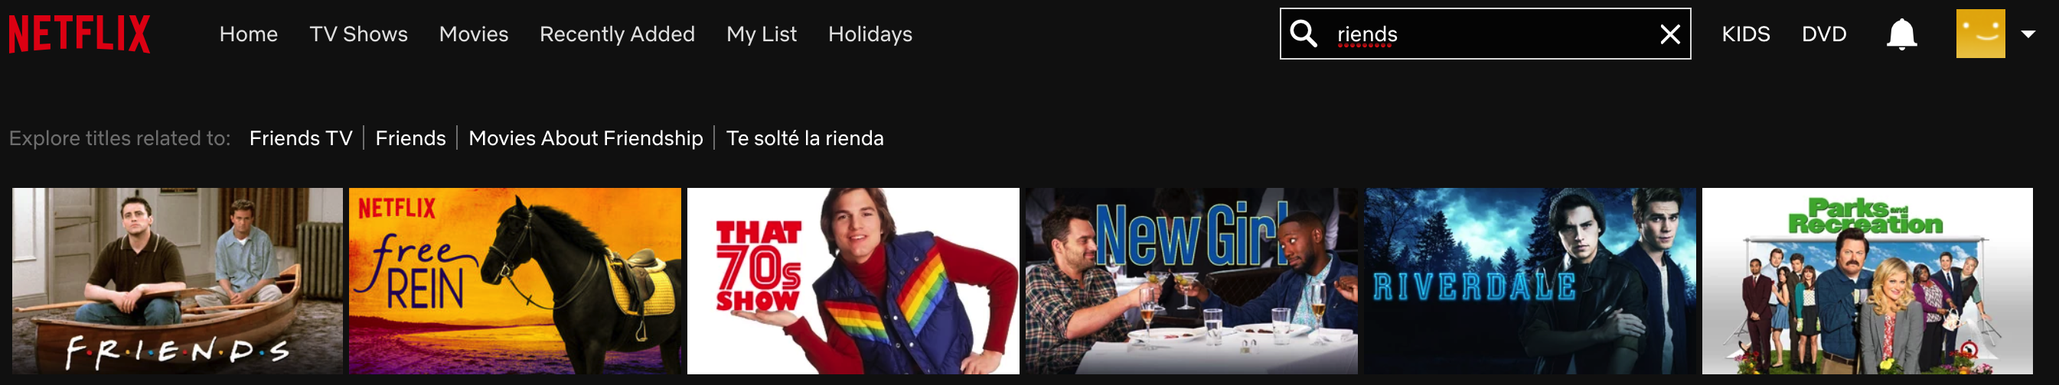
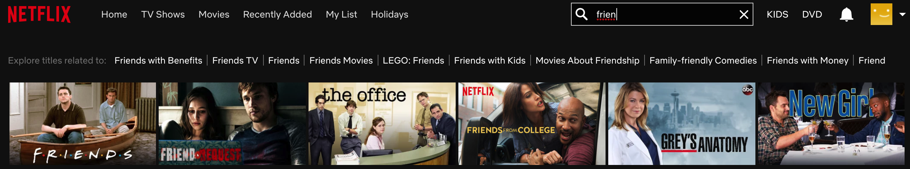
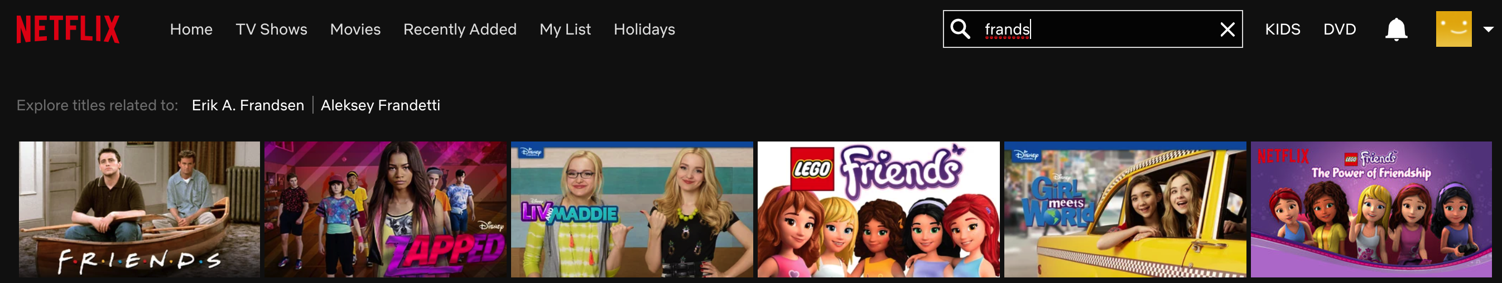
Analyzing Netflix Search Results …1
Simple Query: “Friends”
____________________________________________________________________________________________________________
Missing Prefix: “riends”
____________________________________________________________________________________________________________
Missing Suffix: “frien”
____________________________________________________________________________________________________________
Misspell: “frands”

Slide 4
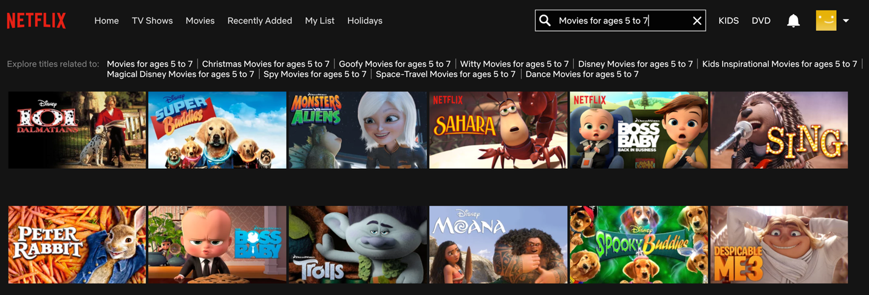
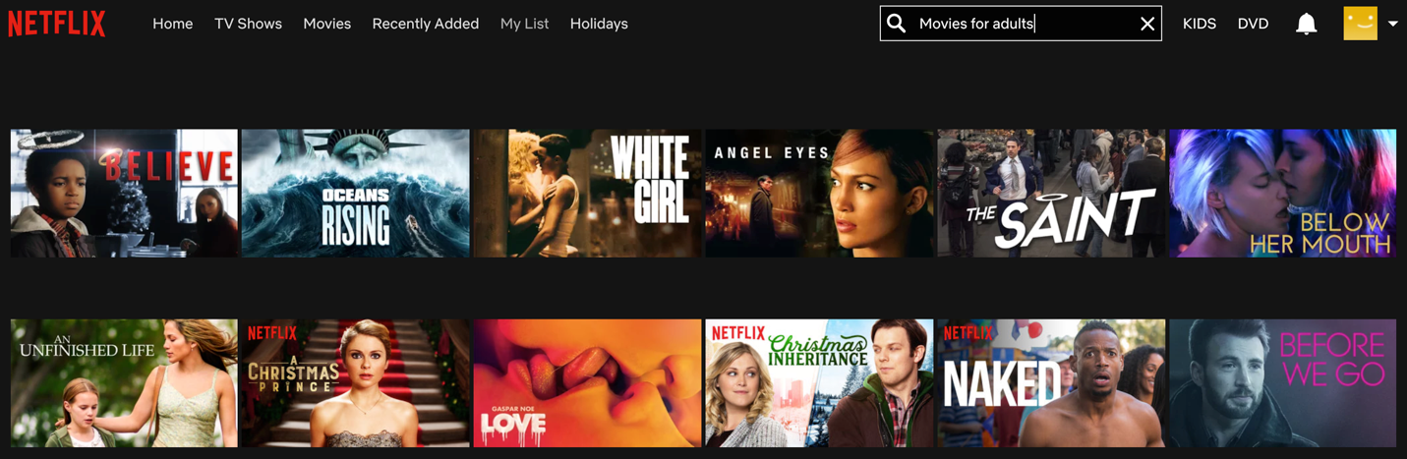
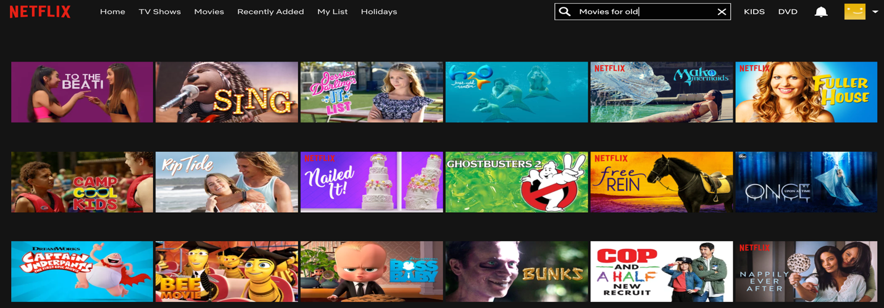
Analyzing Netflix Search Results …2
Age Param Query: “Movies for age 5 to 7”
____________________________________________________________________________________________________________________
Age Param Query: “Movies for adults”
____________________________________________________________________________________________________________________
Age Param Query: “Movies for old”
CS 6200 Fall 2018 Seattle

Slide 5
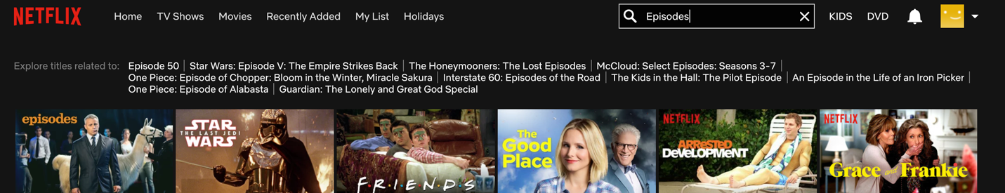
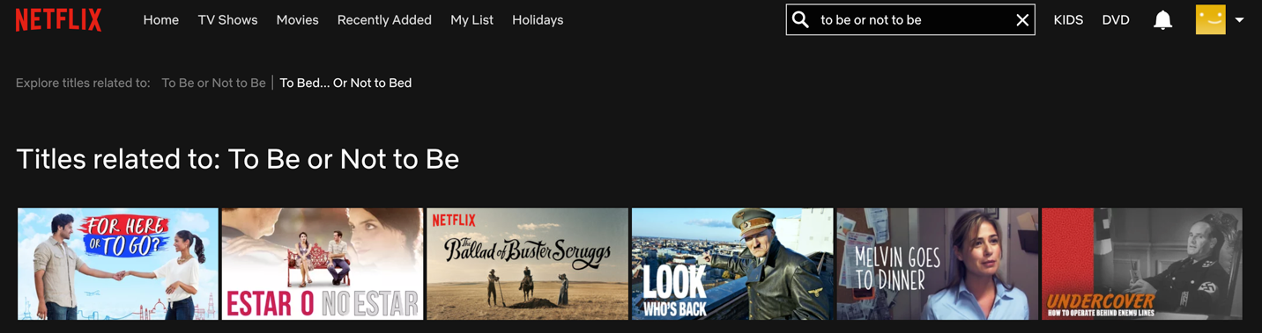
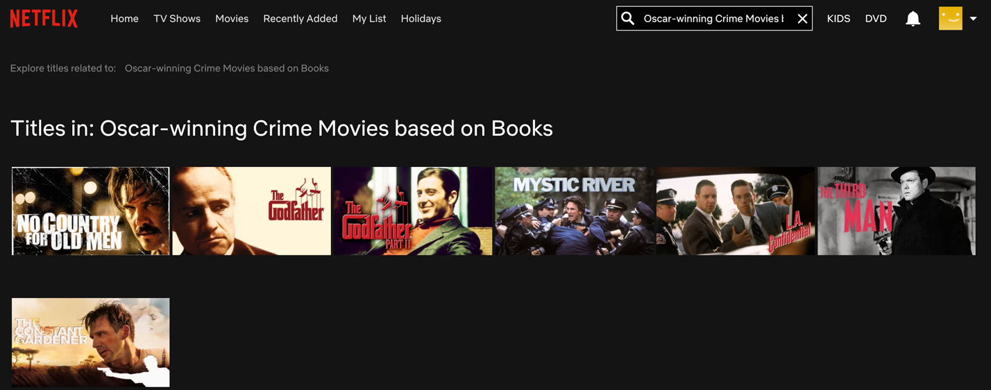
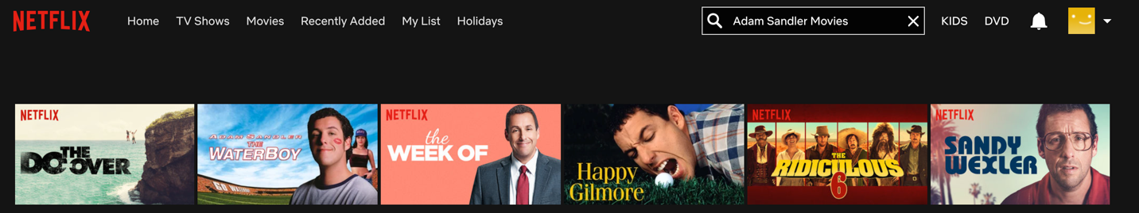
Analyzing Netflix Search Results …3
Vague query: “Episodes”
_____________________________________________________________________________________________________________________________
Stop words query: “to be or not to be”
_____________________________________________________________________________________________________________________________
Complex query: “Oscar-winning Crime Movies based on Books”
_____________________________________________________________________________________________________________________________
Query on movie cast: “Adam Sander Movies”

Slide 6
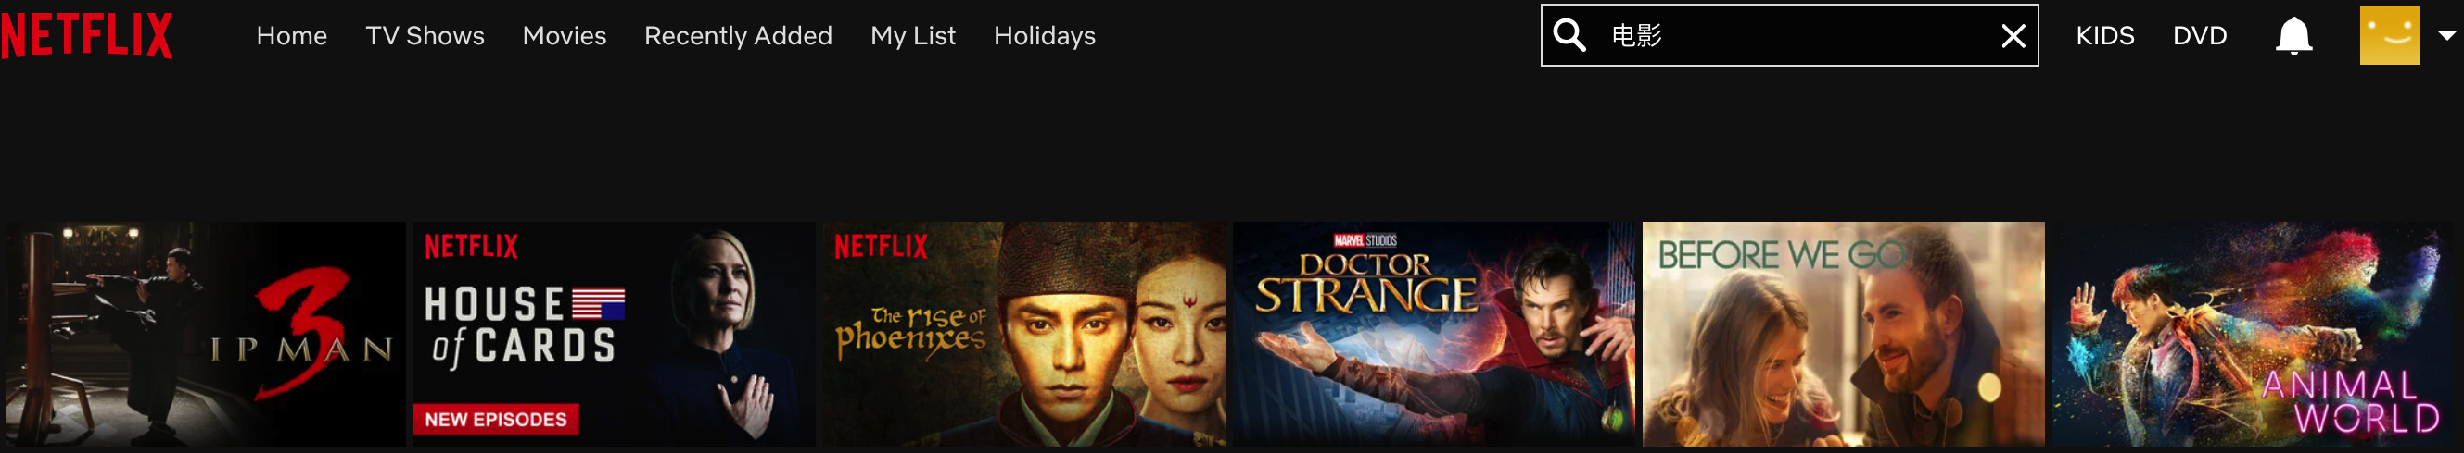
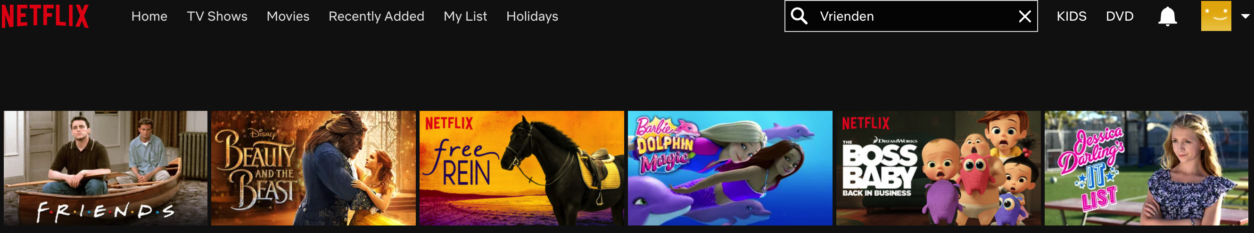
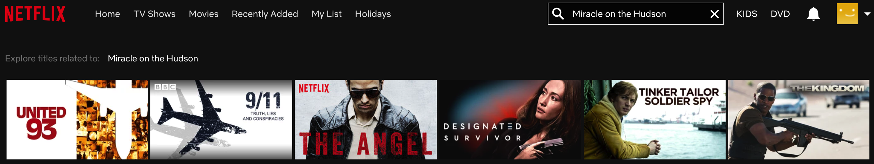
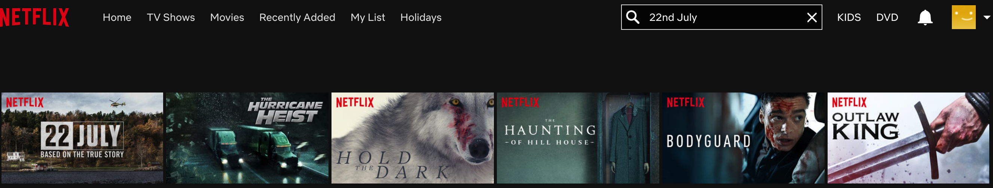
Analyzing Netflix Search Results …4
Chinese Query for “Movie”: “电影”
_____________________________________________________________________________________________________________________________
Dutch query for “Friends”: “Vrienden”
_____________________________________________________________________________________________________________________________
Informative query: “Miracle on the Hudson”
_____________________________________________________________________________________________________________________________
Incident date query: “22nd July”

Slide 7
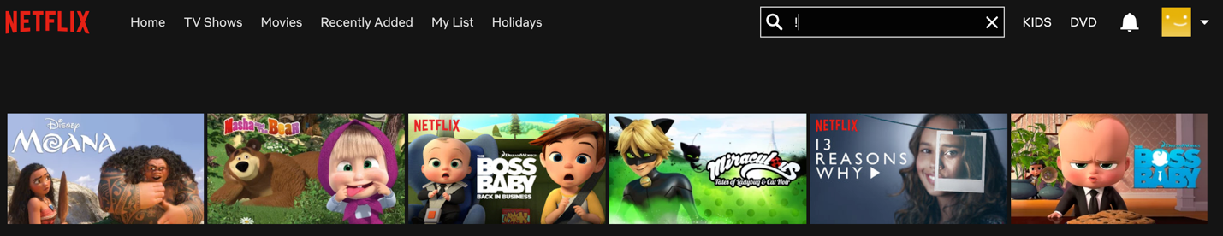
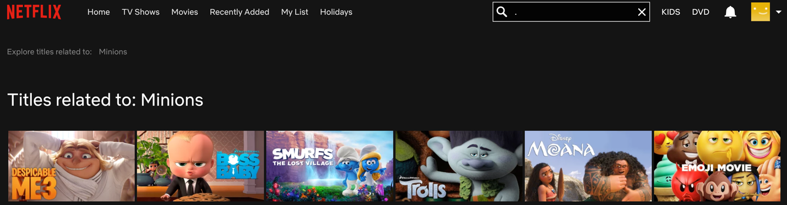
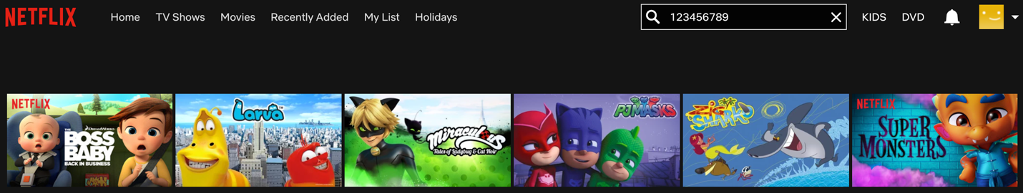
Analyzing Netflix Search Results ...5
Weird/Gibberish Query: “!”
__________________________________________________________________________________________________________________
Weird/Gibberish Query: “."
__________________________________________________________________________________________________________________
Weird Gibberish Query: “123456789”

Slide 8


Data Analysis
When does a user pause, rewind or fast forward.
What day you watch content.
What time you watch content and which shows or movies do you complete.
At which location you watch content.
What devices you use to watch.
When you pause and leave content and if you ever come back.
The ratings given along with searches.
Browsing and scrolling behavior.
Netflix also looks at data within movies. They take various screen shots to look at “in the moment” characteristics.

Slide 9
Summary
We defined Netflix and looked at some interesting stats about it in an overview.
We tried various queries to analyze how Netflix processes them.
We talked about search results and their relevance in ranking.
We analyzed how Netflix keeps track of data for each user.

Slide 10



